Slide 1
Lesson Overview
Stop and think- 2 min to write 1 min to discuss
Review- what we figured out so far and what we want to find out 3 min
Stations instructions- go over routines for moving through stations, evidence they will see in each station and expectations for what to do while in the stations 5-mins
Stations- students move through the 5 stations (7min per station). 35-40 min.
Discussion- discuss what they learned from the evidence, how we should change model and what evidence to add to MEME- 5 mins– this may need to move to next day. If no time skip to Before you go to end lesson
Before you go- 3 mins.
Total time- 50 mins.

Slide 2
LESSON 3 - DAY 1
Notes:
Day 1 Outline
Content goals-
- Decomposers use up air when eating dead matter (in this case dead algae)
- Decomposers grow and multiply
- Decomposers breathe air just like we do (dissolved air in water decreases)
Epistemic goals-
- Evidence and simulations can be used together to develop and test hypotheses.

Slide 3
STOP & THINK!
Grab a handout and put your name and information on the top of the first page.
Complete the STOP & THINK! question on the first page.
Why do you think the fish are suffocating? Give reasons to support your answer.
Notes:
Instructions- hand out packet, one for every student. No need to discuss this. Just have students fill in the stop & think
Materials- student packet for L3 D1, timer, instructions for all stations and evidence set to be split among the stations:
Station 1- evidence 1a, 1b and 1c
Station 2- baggies for baggie experiment
Station 3- 2 computers to watch the videos
Station 4- 4 microscopes and 3 samples. Cards to go with each microscope
Station 5- 2 laptops
Extra: 1 extra laptop
Rationale for this slide- In L2 they learned that fish are not choking on algae but are suffocating due to low dissolved air. They do not yet know why the dissolved air is low– but they know there are little living things on the algae. They don’t yet know that these little living things are decomposers. They know that these little living things might have something to do with it since they use air to breathe.
Instructions- You can have students share for a minute or two but don’t spend too much time on reviewing this question. We would like that kids are on the same page but if they aren’t then have them discuss and all understand that the little living things have something to do with it.

Slide 4



Review:
We figured out:
Fish are suffocating
They are not choking on algae
The pond has low dissolved air and it may have something to do with decomposers
Today:
Today, we want to find out:
What are decomposers?
What are they doing?
Are they related to the fish deaths?
Notes:
3min–Please keep really brief as we need most of the lesson for stations. We also did this in a previous lesson so they already know these points.
Instruction- spend a minute recapping what we learned yesterday and what we want to find out tomorrow:
Yesterday we learned that fish aren’t choking and about the presence of decomposers that eat dead matter.
Today we want to know- what are these decomposers? What are they doing? Are they causing the fish to die?
Rationale- Segue from yesterday’s lesson into todays.

Slide 5

Stations
Today, we will study evidence in stations!
7 minutes in each station (5 stations).
Move when the timer sounds
Read the instructions at each station
Answer questions in your handout at each station.
Give reasons and try to reach agreement about what the evidence means
Notes:
Instructions: Explain routines for working in stations. Explain the routines listed here but also anything you think the kids needs to know/guidelines from when you teach stations in class.
NO need to explain each station, there are instructions in each station and plenty of us to help if needed.
Three stations will be in the classroom and 2 stations are in the design room.
Key points:
- students move as a group with the timer
7 minutes per station
Answer the questions at that station
If finished, observe materials and take notes

Slide 6
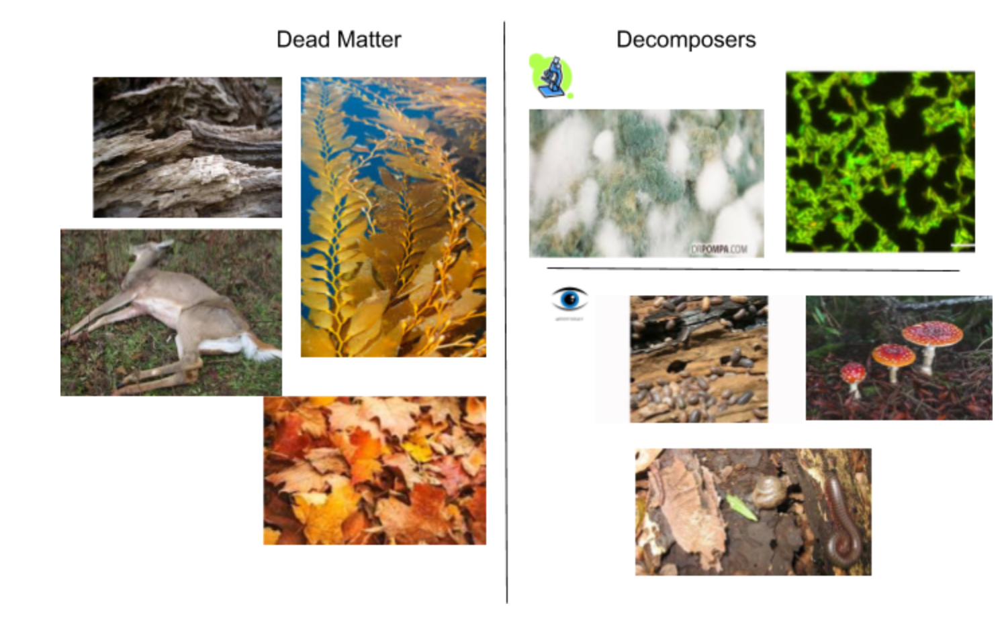
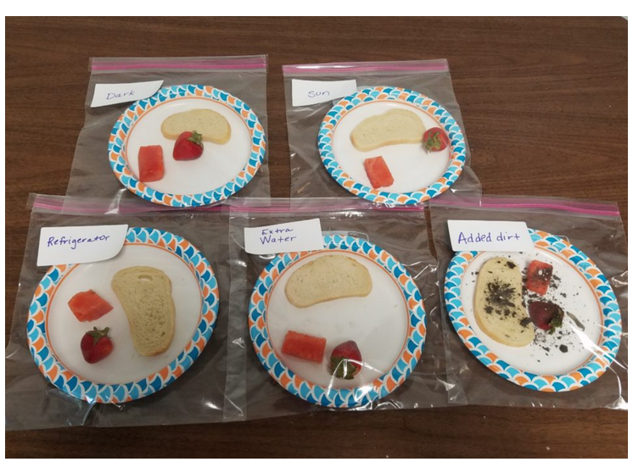
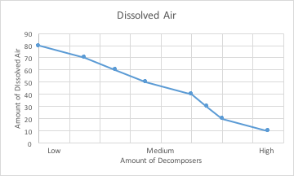
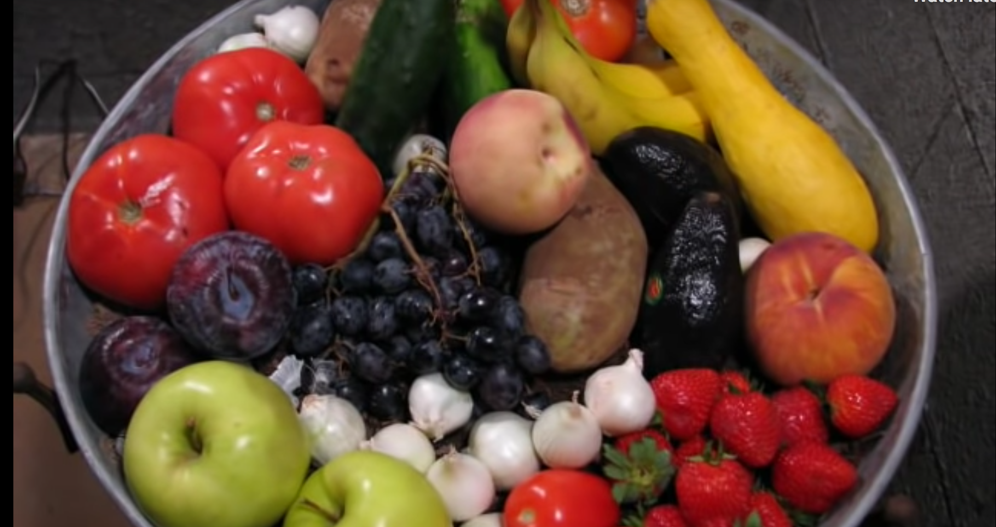

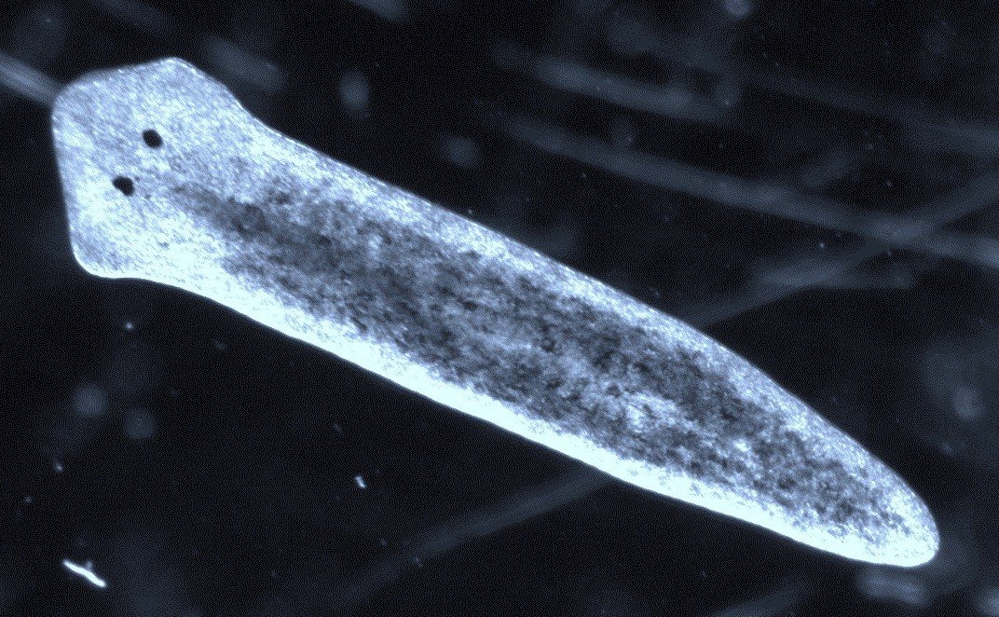
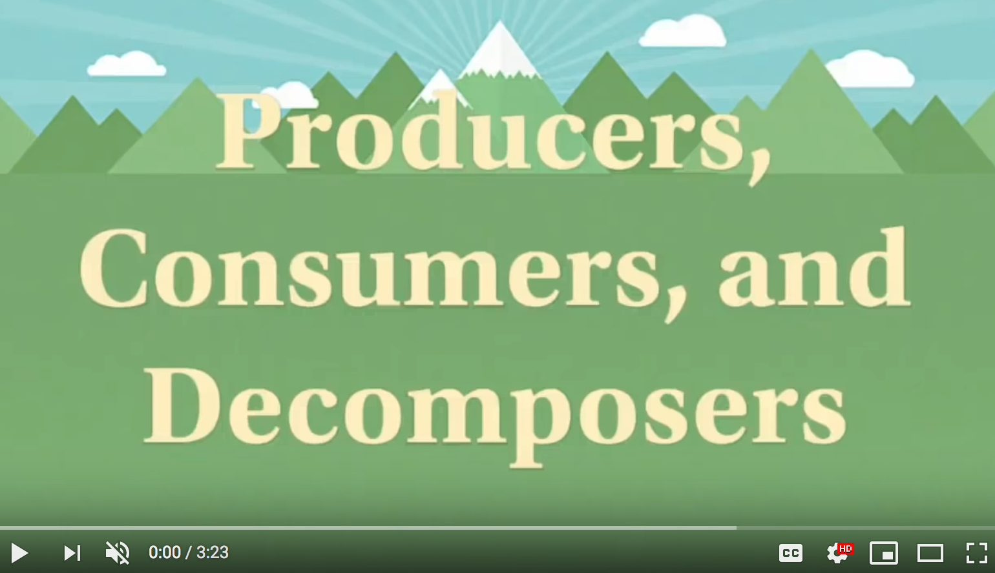
Today we will study evidence in stations to answer our questions.
Station 1-photos & charts
Station 2- experiment
Station 3-videos
Station 4-microscopes
Station 5- producer, consumer, decomposer
Notes:
Stations Overview-
This is a brief overview for YOU (no need to explain to the kids) of the 5 stations. the first stations contains 3 sets of evidence, which are all photos and charts.
The second station is the baggie experiment we set up last week. The third station is videos of what happens to fruit and vegetables over
a longer period of time than the baggie experiment. The fourth station has microscopic (very small living things) that they can see
through microscopes. The fifth station has a video as well.
Tell students what they will encounter in each station (however, there are more comprehensive notes on the next few slides if you would
rather use those. These notes here are just a brief overview)-
In station 1 they will see:
Evidence 1a- a matching game of the names of dead matter and decomposers.
Purpose (for you to know) - naming types of decomposers
Evidence 1b- pictures of live and dead algae and pictures of bacteria to show how they increase on dead matter. Pictures show increase in bacteria.
Purpose (for you to know) - decomposers grow and multiply
Evidence 1c- a graph to show dissolved air decreases with a rise in decomposers. Evidence 5- to show that decomposers breathe air just like we do.
Purpose (for you to know) - the more decomposers there are, the less dissolved air there is.
In station 2 they will see:
Evidence 2- The rotting food from the baggie experiment. They will see 5 baggies, each containing food, each one having been in a
different state sunlight, water, dirt, fridge and air. Students are to look at the food in the bags, examine it, see what they can see. Tell
them NOT TO OPEN THE BAGS!
Purpose (for you to know) - to view decomposers, to see what they look like. To identify type of decomposers. They will also possibly
start to think about what they are doing.
In station 3 they will:
Evidence 4- Watch two time lapse videos of rotting food. In the first video they will watch a bowl of fruit and vegetables rotting over 74
days. They will see the food break down and mold grow. In the second video they will watch a pineapple decompose over time. It
becomes moldy, which grows in stages, then the entire fruit implodes.
Purpose (for you to know) - to see what decomposers do to fruit and vegetables- break them down
In station 4 they will examine slides under microscopes (check scopes with Shannon. Backup video, which can also be used as well
as scopes examination: https://www.atlasobscura.com/articles/watch-these-microscopic-organisms-feast-on-a-dead-worm
In station 5 they will learn about producers, consumers and decomposers by watching a video that explains what they are. They will then do a sort pictures of consumers, producers and decomposers.

Slide 7

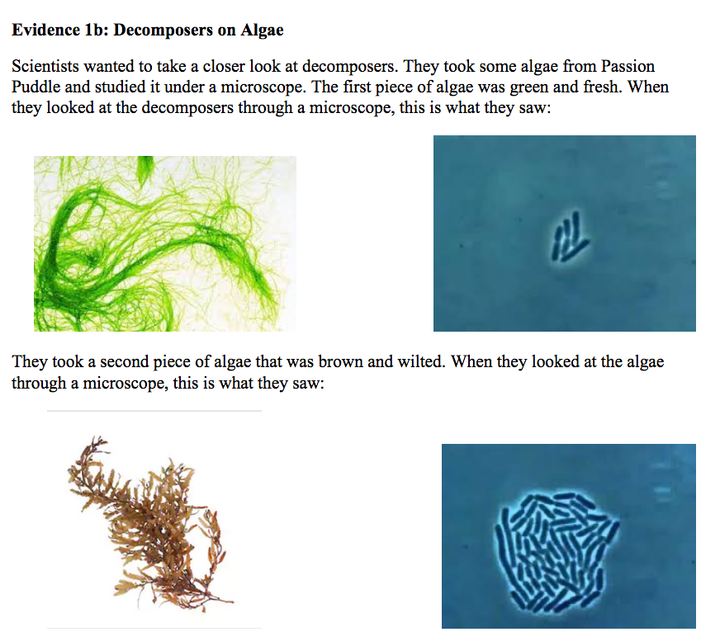
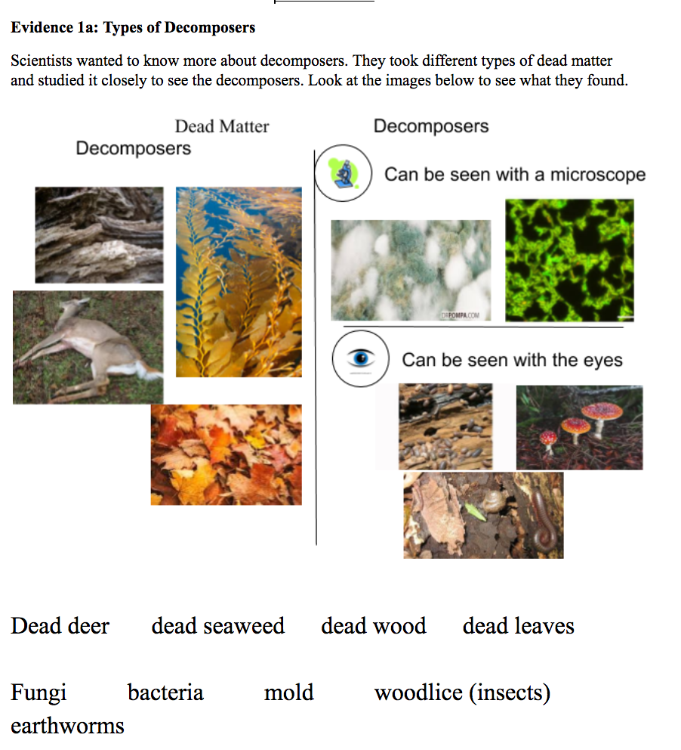
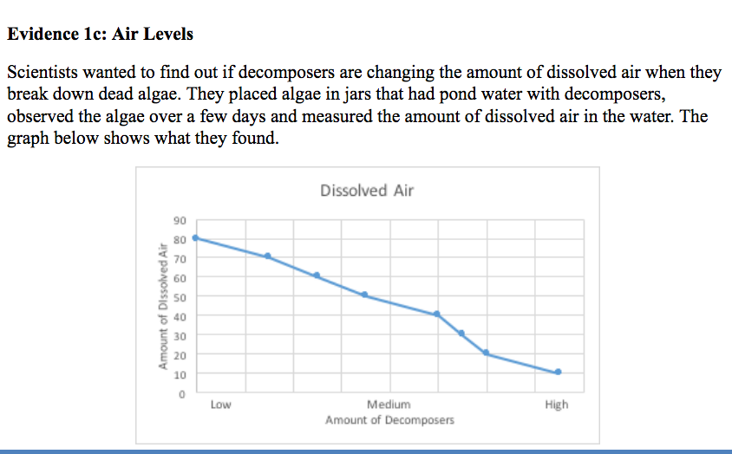
Station 1: Photos and Charts
Notes:
Tell students that in station 1 they will see:
Evidence 1a- a matching game where they need to first, place the paper with the pictures on it onto the desk, then match the words onto the pictures by guessing what they are. In the pictures there are different types of dead matter- deer, leaves, algae and wood and types of decomposers- mold, bacteria, insects, fungi, snails and worms
ONLY when they are finished can they go and look at the answer key. Discuss any pictures/words that don’t understand and try to come to agreement about what they are.
For YOUR knowledge- the purpose of this station is to identify that there are different types of decomposers.
Evidence 1b- pictures of live and dead algae and pictures of bacteria.
For YOUR knowledge- the purpose of this station is to see that decomposers grow and multiply
Evidence 1c- a graph to show amount of dissolved air.
For YOUR knowledge- the purpose of this station is to see that the more decomposers there are, the less dissolved air there is.

Slide 8
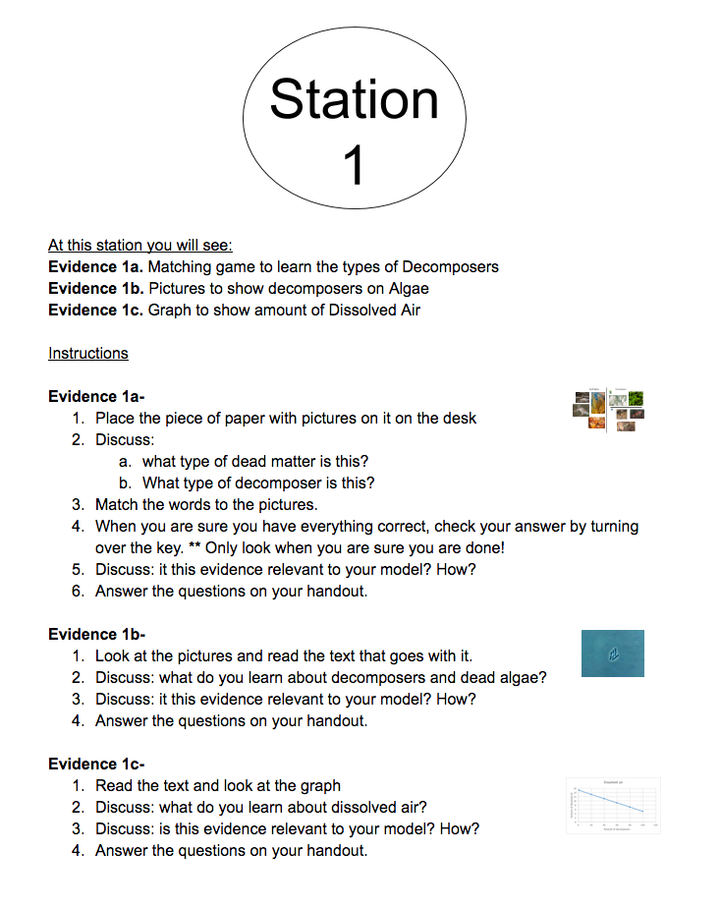
Notes:
Here are the instructions for station 1. They will see:
Evidence 1a- the matching game- do the matching game, discuss the questions, once they are sure they have every name matched to a
picture THEN look at the key. Discuss if the info is relevant to the model and answer the questions on the handout.
Evidence 1b- pictures to show decomposers on algae. Look at the pictures, discuss the questions then answer the questions on the handout.
Evidence 1c- graph to show amount of dissolved air. Read the text and look at the graph, discuss the questions then answer the questions on the handout.
They need to follow the instructions for each specific piece of evidence. For example, in evidence 1a they follow the directions for the matching game but in evidence 1b they look at the pictures and read the text that goes with it. Then there are a few questions they will answer in every station and for every piece of evidence. These questions are:
Discuss: what did you learn about _____ (algae, dissolved air etc)?
Discuss: is this evidence relevant to your model? How? -Think: does this evidence support the model? Not support? Should I keep it in the library? Delete it? Should I link it if it’s important? Stress that students need to be thinking about what this evidence means and what they should do with it. Remember guidelines for good discussions: listening, taking turns and reaching compromises.
Once they have completed all of the steps, then they go to the handout and answer the questions. There is at least one question for every piece of evidence. This asks them to interpret the evidence: see what is is telling us. Remember to keep the question in mind: why are the fish dying?

Slide 9
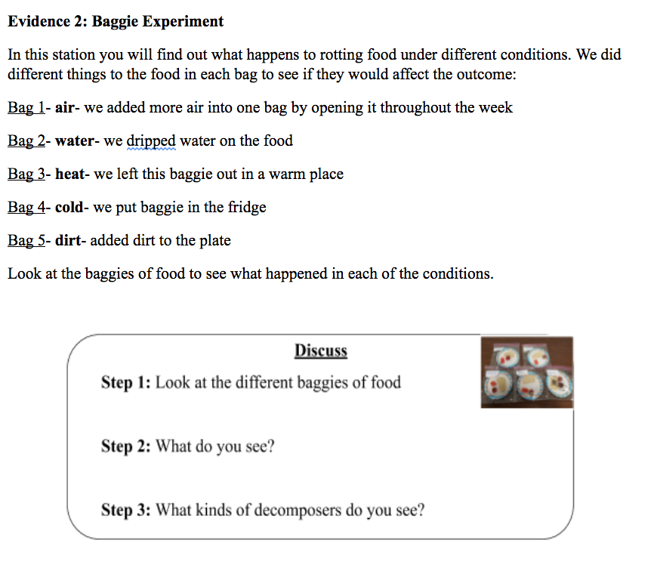
Station 2: Experiment
Notes:
Tell students that in station 2 they will see:
Evidence 2- The rotting food from the baggie experiment. They will see 5 baggies, each containing food, each one having been in a
different state sunlight, water, dirt, fridge and air. Students are to look at the food in the bags, examine it, see what they can see. Tell
them NOT TO OPEN THE BAGS!
For you to know- Purpose- to view decomposers, to see what they look like. To identify type of decomposers. They should see mold- white or black. They will also possibly start to think about what the decomposers are doing to the food- breaking it down, “eating it” etc.

Slide 10
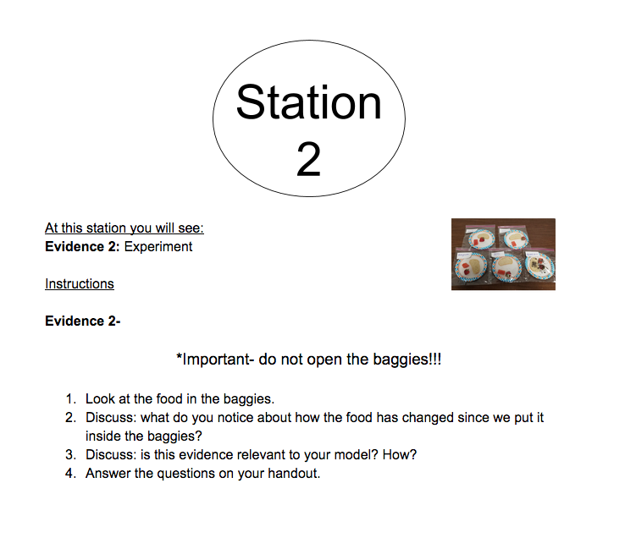
Notes:
Instructions for station 2-
Without opening the baggies, look at the food inside the baggies. Discuss what they notice about how the food has changed and then
discuss if this evidence is relevant to their model. Then answer the questions on the handout.

Slide 11
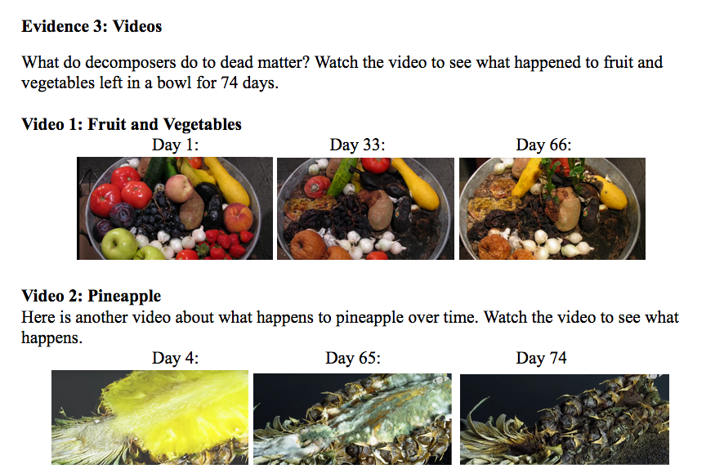
Station 3: Videos
Notes:
Tell them that in station 3 they will:
Evidence 3- Watch two time lapse videos of rotting food. In the first video they will watch a bowl of fruit and vegetables rotting over 74 days. In the second video they will watch a pineapple decompose over time.
For you to know- the purpose of this experiment is for them to see what decomposers do to fruit and vegetables- break them down. In video 1 They will see the food break down and mold grow. In video 2 they will see the pineapple becomes moldy, which grows in stages, then the entire fruit implodes.

Slide 12
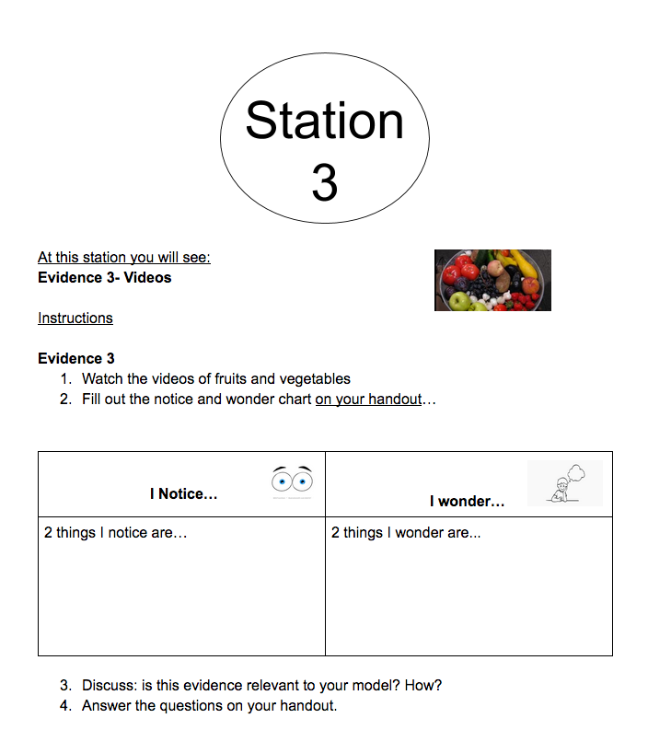
Notes:
Instructions for station 3-
Watch the videos of the fruits and vegetables. They can rewind and watching it again, stop and start to look at a part of it more closely.
Make sure they all watch both videos. Then fill in the notice and wonder chart by writing down 2 things they notice and 2 things they
wonder on their own handout. Then discuss if this information is relevant to their model then answer the questions on the handout.

Slide 13
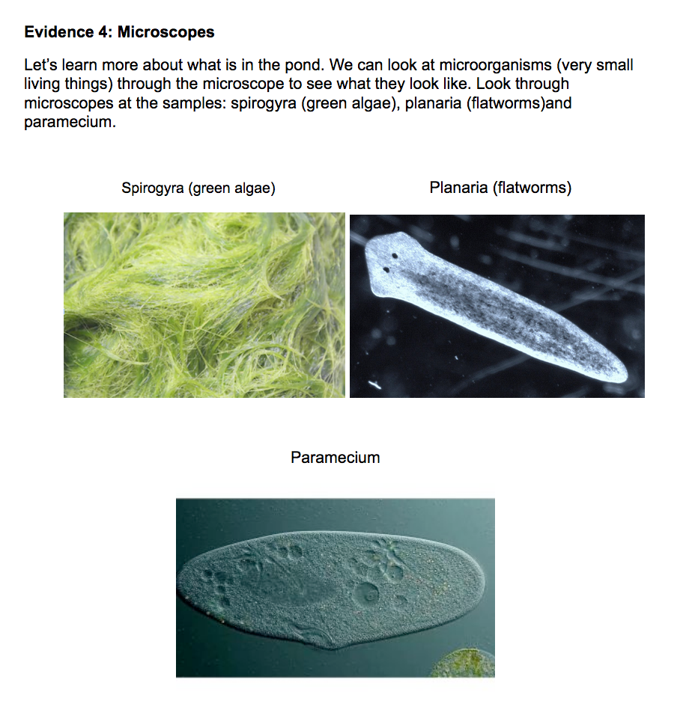
Station 4: Microscopes
Notes:
In station 4 they will examine samples under microscopes. They will see spirogyra which is a type of green algae, Planaria which is a flatworm, and a single celled organism (living thing) called paramecium.
For you to know- they are looking at algae up close and two different types of decomposers. The questions on the handout ask them to describe the algae and identify whether the other two samples are organisms. They should enjoy seeing this matter up close, especially the decomposers! Because many decomposers are microscopic, it will be fun for them to see them up close.

Slide 14
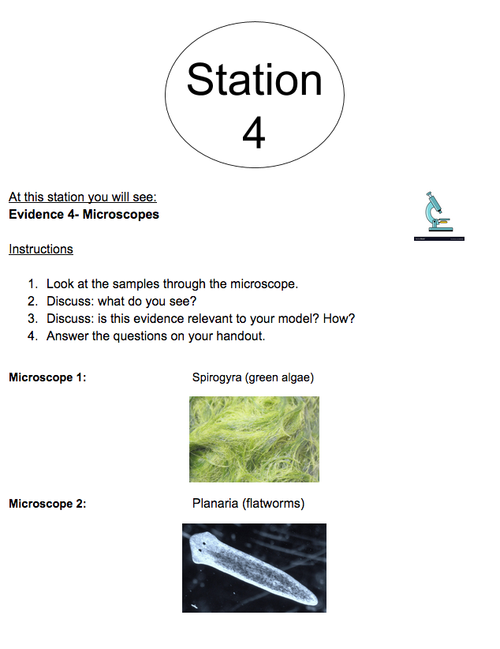
Station 4: Microscopes
Notes:
Instructions
Look at the samples through the microscope. As they look, think: what do I see? What is it? What can I see through the microscope that I can’t see with my eyes? They will discuss what they see and if this info is relevant to their model. Then they will answer the questions on the handout.

Slide 15
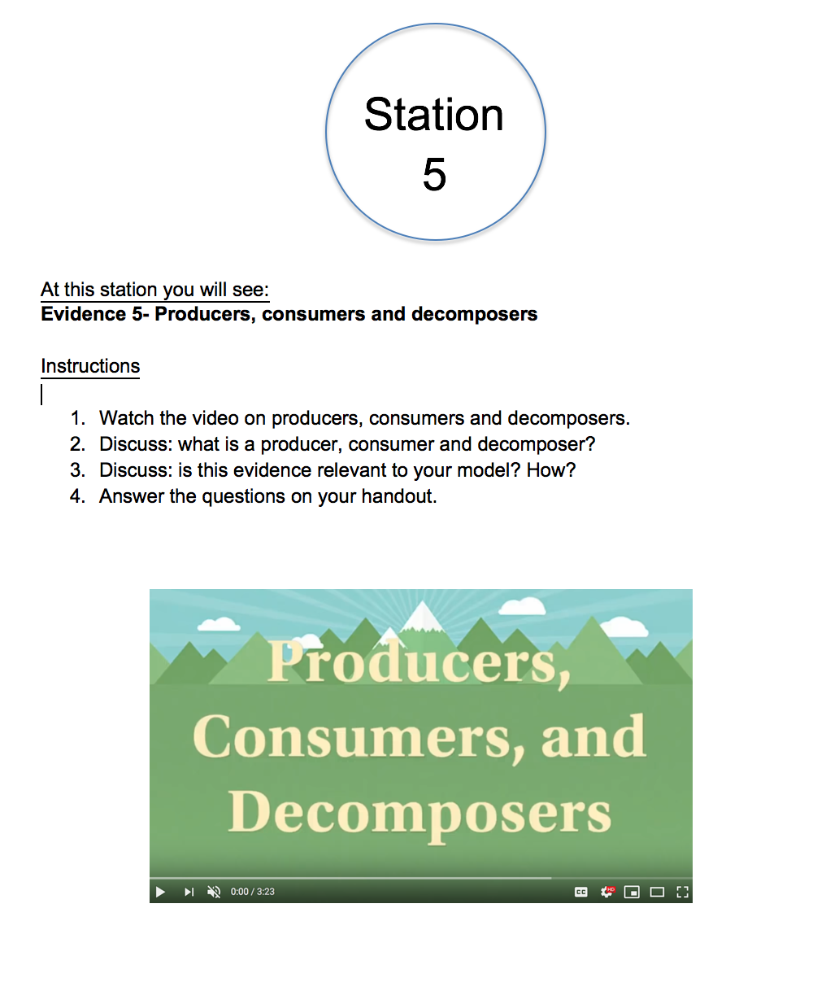
Station 5: Producer,
Consumer, Decomposer
Notes:
Instructions:
In Station 5 they watch a video that explains consumers, producers and decomposers. The video gives examples of each. After they learn about the different categories, they will do a matching game where they match pictures to the names. For example, they will match a picture of a deer to the label “consumer”. The pictures are color coded on the back so they can check their answers when they finish and adjust if need be. They can also watch the video multiple times to gain understanding. Note: they must stop watching at time: 1:30 and then do the sorting game.

Slide 16

Station 5: Producer,
Consumer, Decomposer
Notes:
Instructions
Watch the video, discuss the questions on the instructions sheet, then answer questions on handout.
https://www.youtube.com/watch?v=MPZI2M1fDi8

Slide 17
BEFORE YOU GO
Answer the BEFORE YOU GO question on your handout.
Reflect on what we learned today from the evidence. What do we still not know?
Notes:
3min--- This is an exit question, you can ask one or two students to share if time permits but this is really for them to do. A discussion is not necessary.
Students might say that they don’t know why the dissolved air is going down, why the algae is growing or why the fish are dying. These are a few suggestions, other ideas will come up also. This is really for them to check in about what they still need to know. There is no need to go over a specific concept or idea at this time.
Collect packets at end of the lesson.

Slide 18
Stations
Notes:
Now we will have students begin the stations.
Preparation- Clear off desks and floor area around desks so students can walk around easily without tripping over things. Make sure every student has a handout and a pencil. Set the timer for 7 minutes.
Begin!

Slide 19

Group Discussion
What did we learn from the evidence?
How should we change our model given the new evidence? Why?
What pieces of evidence should we add to the library in MEME? Why?
Notes:
Unlikely we will have time for this but if there is time have kids work in groups for a few min to discuss these questions (if not time we will pick up from this point tomorrow)
Instruction
Now, have students go back to their regular seats and work in their groups to think about the three questions.
In particular they should make sure all members of the group understood each evidence and what might they change/add/remove from their model given this new information.
For example they may decide to add decomposers if they don’t have that in the model yet; they can add a mechanism that shows decomposers use air, etc
For the third question you may want to clarify that we need to “import’ some evidence into MEME, but we need to decide which pieces. Maybe we don’t need all of them, maybe we can combine some of them. Push the students to think about what evidence was most important and which evidence seems to say the same thing (and maybe can be combined)

Slide 20
Class Discussion
What did we learn from the evidence?
How should we change our model given the new evidence? Why?
What pieces of evidence do we want to add to the library in MEME? Why?
Notes:
Instructions
Have a class discussion about the two questions (no need to discuss models, that is up to the groups to decide).
Keep discussion of question 1 brief!
The key discussion here is the second question. What should we add to the library (we need to know this so we can add the evidence the kids want before tomorrow)
Students can opt to combine some evidence that seems to show the same thing
Arguably the key evidence is evidence 5, the graph that shows use of dissolved air
And some combination of evidences 1 and 4 and also 2 and 3--- we need evidence that shows that decomposers are microscopic (E 3 and E2 under microscope) and that they break down dead matter (E 2 and E4) and that they use dissolved air (E5)

